Slide 1
Learning Objective
I will be able to determine the effects of linear changes of scale and origin and apply concepts of CDF on CRVs
Success Criteria
At the end of the lesson, I will be able to:
4.2.2 Examine the concepts of a probability density function, cumulative distribution function, and probabilities associated with a continuous random variable given by integrals; examine simple types of continuous random variables and use them in appropriate contexts
4.2.4 Examine the effects of linear changes of scale and origin on the mean and the standard deviation

Slide 2
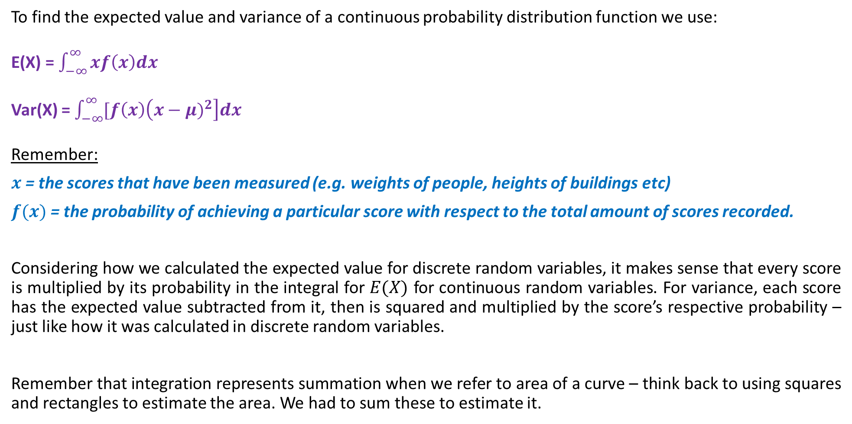
Review: Expected Value, Variance and Standard Deviation for CRVs
To find the expected value and variance of a continuous probability distribution function we use:
E(X) = $\int_{−∞}^{∞}{xf\left(x\right)dx}$
Var(X) = $\int_{−∞}^{∞}{[f\left(x\right)\left(x−μ)^{2}\right]dx}$
Remember:
$x$= the scores that have been measured (e.g. weights of people, heights of buildings etc)
$f(x)$= the probability of achieving a particular score with respect to the total amount of scores recorded.
Considering how we calculated the expected value for discrete random variables, it makes sense that every score is multiplied by its probability in the integral for $E(X)$ for continuous random variables. For variance, each score has the expected value subtracted from it, then is squared and multiplied by the score’s respective probability – just like how it was calculated in discrete random variables.
Remember that integration represents summation when we refer to area of a curve – think back to using squares and rectangles to estimate the area. We had to sum these to estimate it.

Slide 3
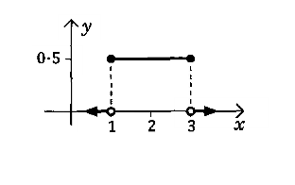
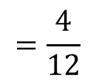
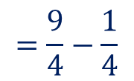
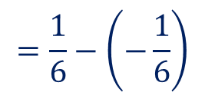
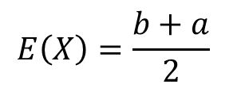
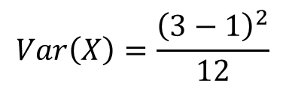
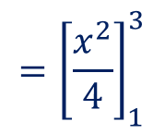
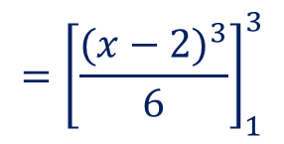
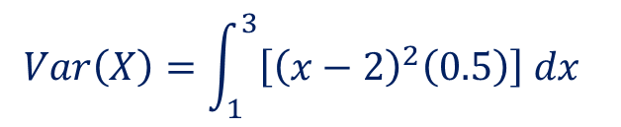
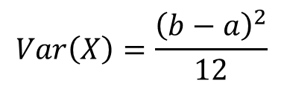
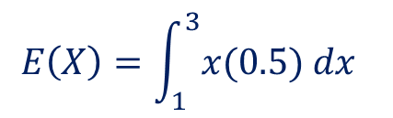

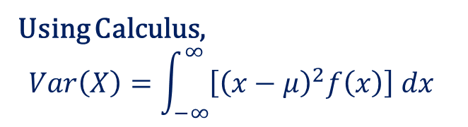
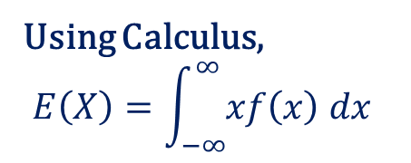
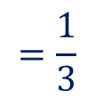
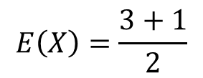
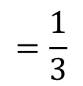

Daily Review
Determine the expected value and variance for the following probability distribution function.
$$E\left(X\right)=\frac{b+a}{2}$$
$$Var\left(X\right)=\frac{{\left(b−a\right)}^{2}}{12}$$
$$E\left(X\right)=\frac{3+1}{2}$$
$$Var\left(X\right)=\frac{{\left(3−1\right)}^{2}}{12}$$
$$=2$$
$$=\frac{4}{12}$$
Using Calculus,
$$Var\left(X\right)=\int_{−∞}^{∞}{\left[{\left(x−μ\right)}^{2}f\left(x\right)\right] dx}$$
Using Calculus,
$$E\left(X\right)=\int_{−∞}^{∞}{xf\left(x\right) dx}$$
$$=\frac{1}{3}$$
$$Var\left(X\right)=\int_{1}^{3}{\left[{\left(x−2\right)}^{2}\left(0.5\right)\right] dx}$$
$$E\left(X\right)=\int_{1}^{3}{x(0.5) dx}$$
$$={\left[\frac{{(x−2)}^{3}}{6}\right]}_{1}^{3}$$
$$={\left[\frac{x^{2}}{4}\right]}_{1}^{3}$$
$$=\frac{9}{4}−\frac{1}{4}$$
$$=\frac{1}{6}−\left(−\frac{1}{6}\right)$$
$$=\frac{1}{3}$$
$$=2$$

Slide 4
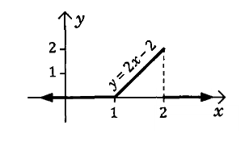
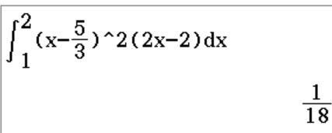
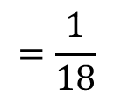
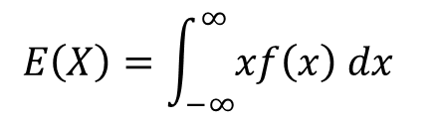
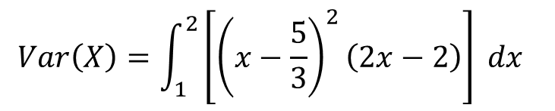
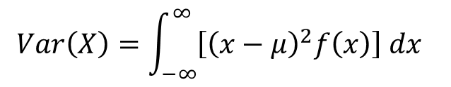
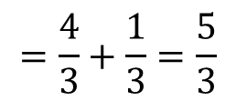
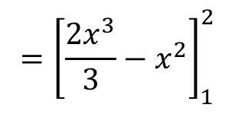
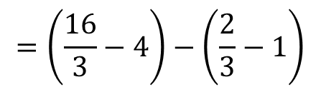
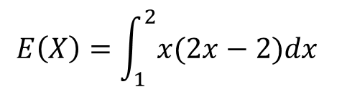
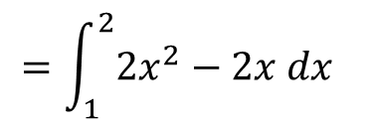
Daily Review
Determine the expected value and variance for the following probability distribution function.
$$E\left(X\right)=\int_{−∞}^{∞}{xf\left(x\right) dx}$$
$$Var\left(X\right)=\int_{−∞}^{∞}{\left[{\left(x−μ\right)}^{2}f\left(x\right)\right] dx}$$
$$E\left(X\right)=\int_{1}^{2}{x(2x−2)dx}$$
$$Var\left(X\right)=\int_{1}^{2}{\left[{\left(x−\frac{5}{3}\right)}^{2}\left(2x−2\right)\right] dx}$$
$$=\int_{1}^{2}{2x^{2}−2x dx}$$
$$=\frac{1}{18}$$
$$={\left[\frac{2x^{3}}{3}−x^{2}\right]}_{1}^{2}$$
$$=\left(\frac{16}{3}−4\right)−\left(\frac{2}{3}−1\right)$$
$$=\frac{4}{3}+\frac{1}{3}=\frac{5}{3}$$

Slide 5
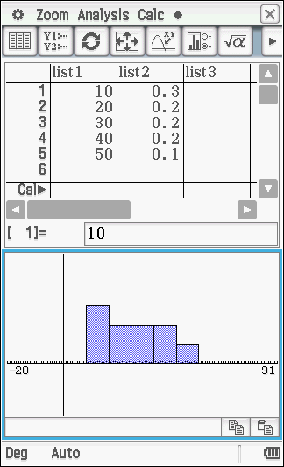
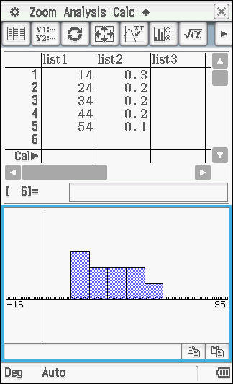
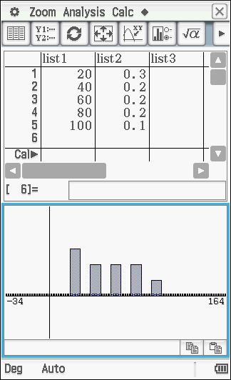
Change of Scale and Origin for CRVs
Recall that in discrete random variables, we looked at how change of scale and origin could affect the expected value and variance. They work in the SAME WAY for continuous random variables.
If we have a change of origin (e.g. X + 4) only the mean or expected value is affected. As every score has 4 added to it, the overall expected value would increase by 4 but the measure of how far apart each score is in relation to the mean (i.e. variance) will remain the same. The entire distribution has just been shifted to the right by 4 units.
If we have a change in scale (e.g. 2X) both the mean and variance are affected, because the dispersion of the scores will increase which affects our measure of spread.
Above is a visual on how this works using the classpad. In the first (LHS) diagram, the original PDF is shown.
If we change the origin and add four to each value of X (middle diagram), the dispersion remains the same, but notice that the x-axis values have increased by 4.
In the last diagram (RHS) a change of scale has affected both the expected value and spread of values, hence variance also changes.

Slide 6
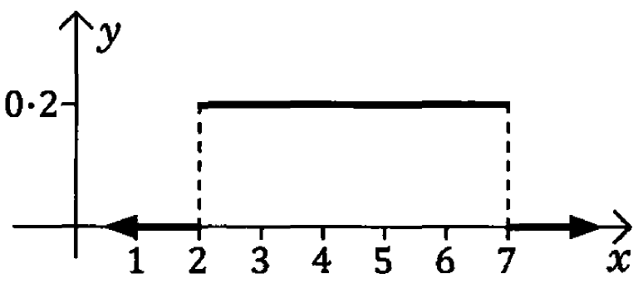
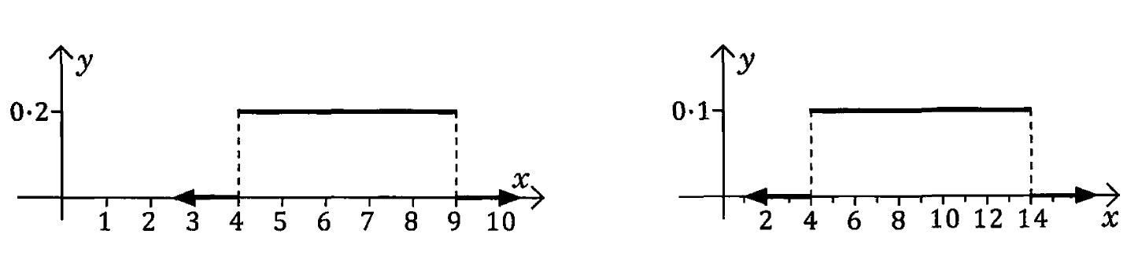
Guided Practice
Use calculus to determine the mean (expected value) and variance of the PDF below.
Use your answer above to determine the mean and variance of the PDFs shown below.

Slide 7


Guided Practice
Use calculus to determine the mean (expected value) and variance of the PDF below.
EXPECTED VALUE:
$$\int_{2}^{7}{0.2xdx=\left[0.1x^{2}\right]\begin{matrix}7 \\ 2\end{matrix}}$$
$$=0.1\left(49\right)−0.1\left(4\right)$$
$=4.5$
VARIANCE:
$$\int_{2}^{7}{0.2(x−{4.5)}^{2}dx=\left[\frac{1}{15}(x−4.5)^{3}\right]\begin{matrix}7 \\ 2\end{matrix}}$$
$$=\frac{1}{15}(7−4.5)^{3}−\frac{1}{15}(2−4.5)^{3}$$
$=\frac{25}{12}$

Slide 8
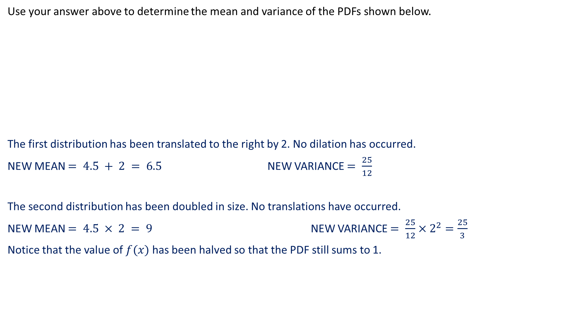
Guided Practice
Use your answer above to determine the mean and variance of the PDFs shown below.
The first distribution has been translated to the right by 2. No dilation has occurred.
NEW MEAN $= 4.5 + 2 = 6.5$ NEW VARIANCE $= \frac{25}{12}$
The second distribution has been doubled in size. No translations have occurred.
NEW MEAN $= 4.5 × 2 = 9$ NEW VARIANCE $= \frac{25}{12}×2^{2}=\frac{25}{3}$
Notice that the value of $f(x)$ has been halved so that the PDF still sums to 1.

Slide 9
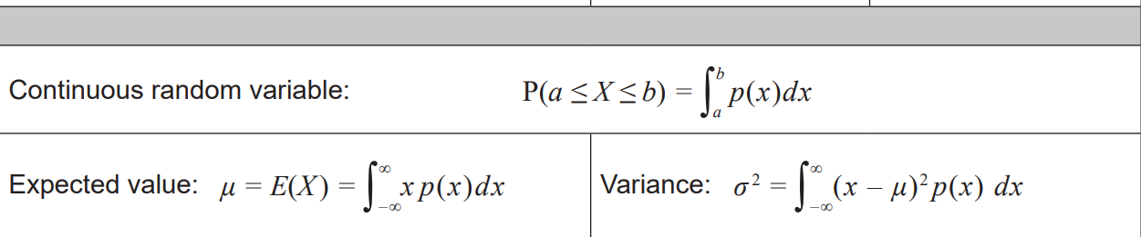
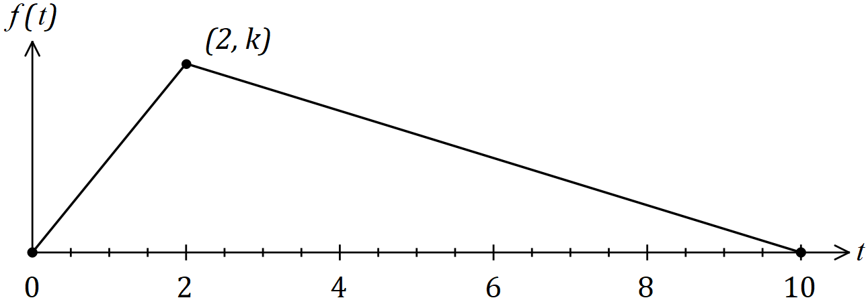
Guided Practice (WAEP 2018 – CALC ASSUMED)
The time T to process orders at a warehouse is a random variable which can take any value in the interval 0 to 10 minutes. The graph of the triangular probability density function of T is shown below.
a) Determine the value of k. (1 mark)
b) Determine the probability that the time to process an order takes less than 1 minute and 30 seconds.
(3 marks)
c) Determine the mean time to process an order. (4 marks)
The variance of T is 4 minutes 40 seconds.
d) Two new procedures will affect the processing time of an order. The first will decrease the time by 25% and
the second will then add 50 seconds. Determine the new mean and standard deivation of the time to
process an order. (3 marks)

Slide 10

Guided Practice (WAEP 2018 – CALC ASSUMED)
The time T to process orders at a warehouse is a random variable which can take any value in the interval 0 to 10 minutes. The graph of the triangular probability density function of T is shown below.
a) Determine the value of k. (1 mark)
The area of the triangle must sum to 1 since the PDF must sum to 1.
$$1=\frac{1}{2}×base×height$$
$$1=\frac{1}{2}×10×k$$
$$k=\frac{1}{5}$$

Slide 11

Guided Practice (WAEP 2018 – CALC ASSUMED)
The time T to process orders at a warehouse is a random variable which can take any value in the interval 0 to 10 minutes. The graph of the triangular probability density function of T is shown below.
b) Determine the probability that the time to process an order takes less than 1 minute and 30 seconds.
(3 marks)
The line from $t=0$ and $t=2$ is $f\left(t\right)=\frac{t}{10}$
$$P\left(T<1.5\right)=\int_{0}^{1.5}{\frac{t}{10}}dt=\left[\frac{t^{2}}{20}\right]\begin{matrix}1.5 \\ 0\end{matrix}$$
$$= \frac{9}{80}$$

Slide 12

Guided Practice (WAEP 2018 – CALC ASSUMED)
The time T to process orders at a warehouse is a random variable which can take any value in the interval 0 to 10 minutes. The graph of the triangular probability density function of T is shown below.
c) Determine the mean time to process an order. (4 marks)
The line from $t=2$ to $t=10$ is $g\left(t\right)=−\frac{1}{40}(t−10)$
$E\left(T\right)=\int_{0}^{2}{(t)\frac{t}{10}dt+\int_{2}^{10}{−\frac{1}{40}(t−10) (t)dt}}$
$E\left(T\right)=4$ minutes

Slide 13
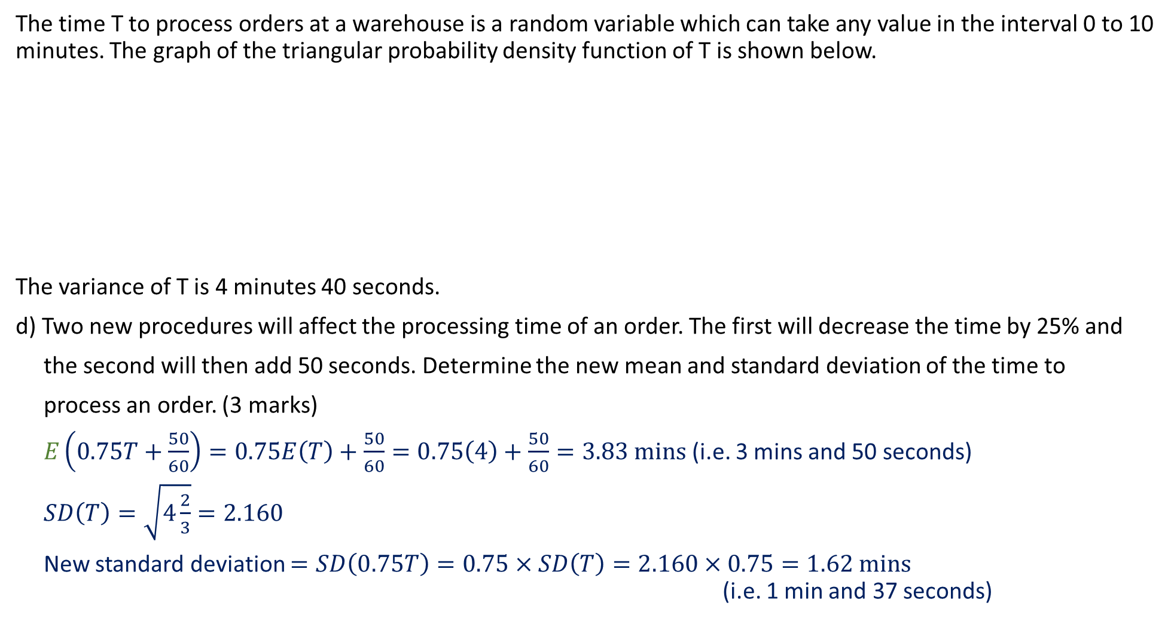
Guided Practice (WAEP 2018 – CALC ASSUMED)
The time T to process orders at a warehouse is a random variable which can take any value in the interval 0 to 10 minutes. The graph of the triangular probability density function of T is shown below.
The variance of T is 4 minutes 40 seconds.
d) Two new procedures will affect the processing time of an order. The first will decrease the time by 25% and
the second will then add 50 seconds. Determine the new mean and standard deviation of the time to
process an order. (3 marks)
$E\left(0.75T+\frac{50}{60}\right)=0.75E\left(T\right)+\frac{50}{60}=0.75\left(4\right)+\frac{50}{60}=3.83 mins$ (i.e. 3 mins and 50 seconds)
$SD\left(T\right)=\sqrt{4\frac{2}{3}}=2.160$
New standard deviation $=SD\left(0.75T\right)=0.75×SD\left(T\right)=2.160×0.75=1.62 mins$ (i.e. 1 min and 37 seconds)

Slide 14
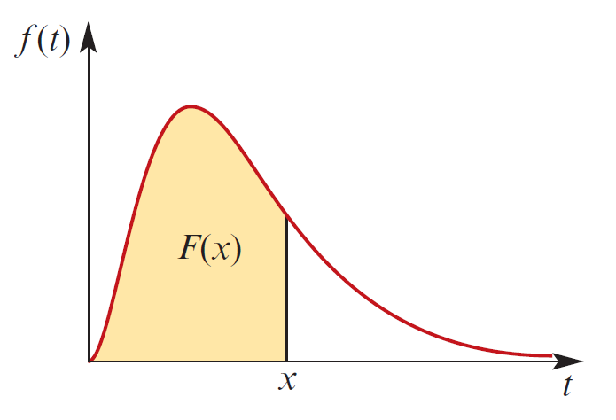
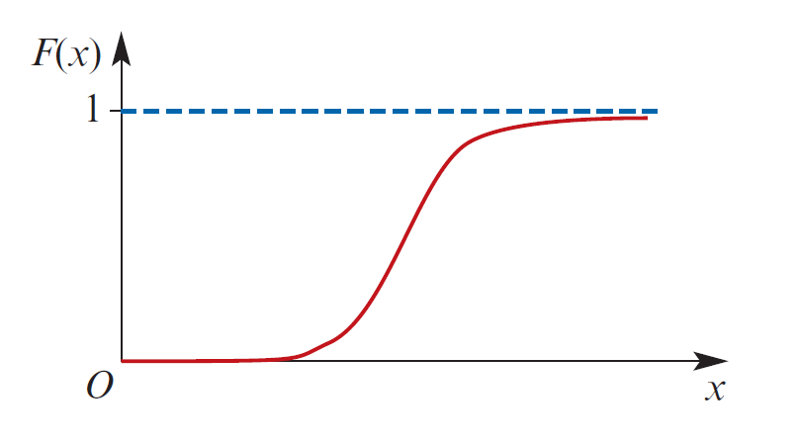
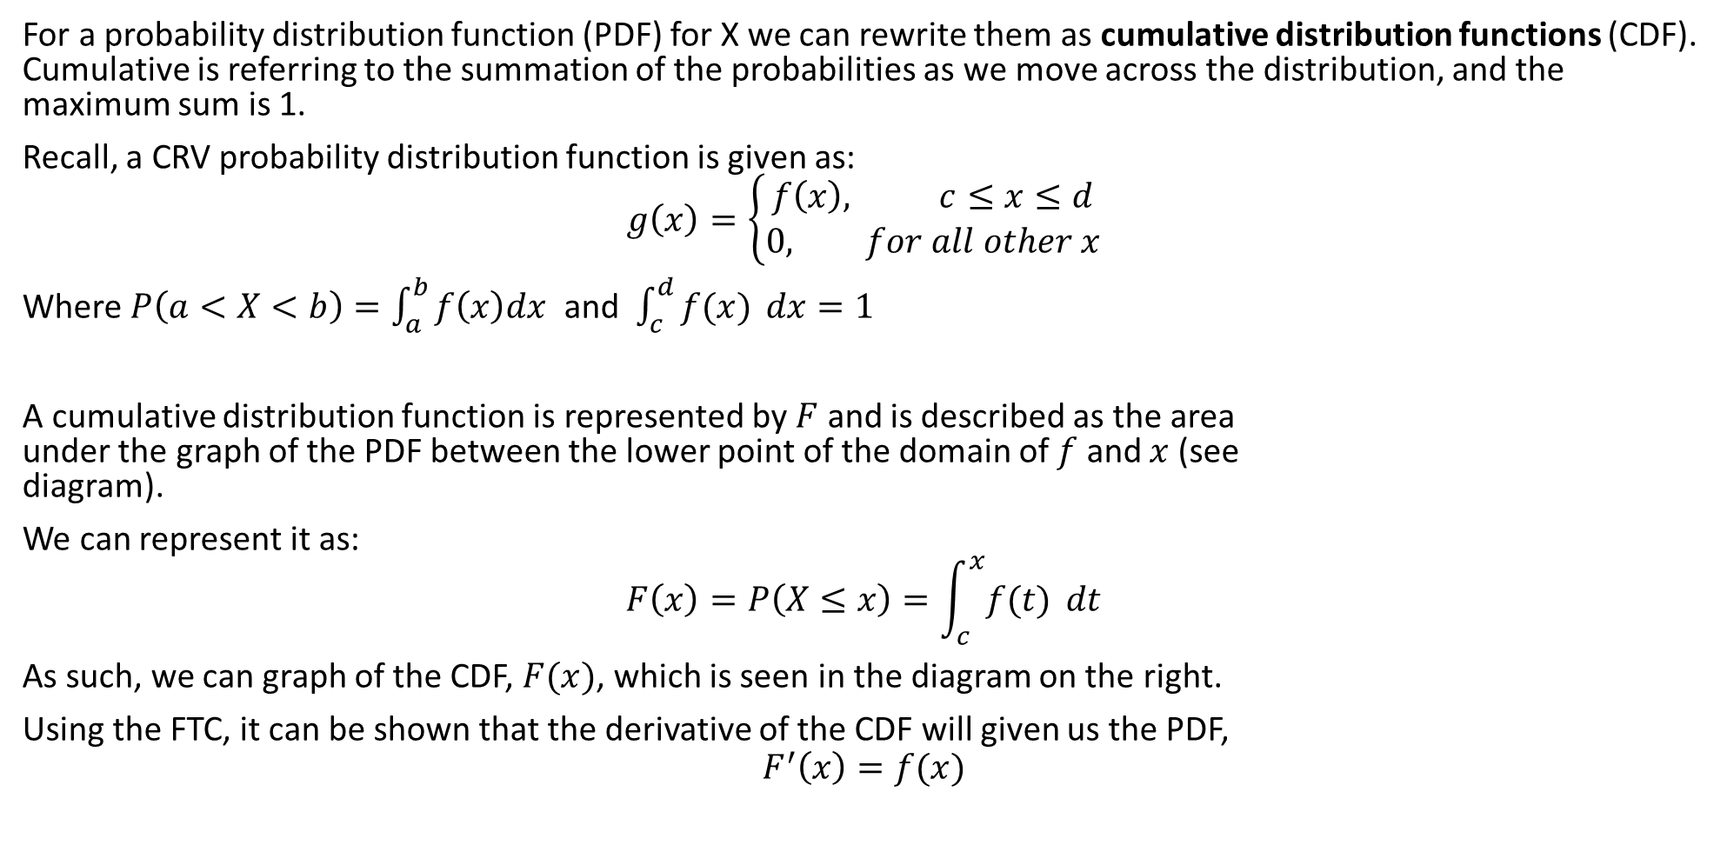
Cumulative Distribution Functions for CRVs
For a probability distribution function (PDF) for X we can rewrite them as cumulative distribution functions (CDF). Cumulative is referring to the summation of the probabilities as we move across the distribution, and the maximum sum is 1.
Recall, a CRV probability distribution function is given as:
$$g\left(x\right)=\left\{\begin{aligned}f\left(x\right), c≤x≤d \\ 0, for all other x\end{aligned}\right.$$
Where $P\left(a<X<b\right)=\int_{a}^{b}{f\left(x\right)dx}$ and $\int_{c}^{d}{f(x)} dx=1$
A cumulative distribution function is represented by $F$ and is described as the area under the graph of the PDF between the lower point of the domain of $f$ and $x$ (see diagram).
We can represent it as:
$$F\left(x\right)=P\left(X≤x\right)=\int_{c}^{x}{f(t)} dt$$
As such, we can graph of the CDF, $F(x)$, which is seen in the diagram on the right.
Using the FTC, it can be shown that the derivative of the CDF will given us the PDF,
$$F^{′}\left(x\right)=f(x)$$

Slide 15
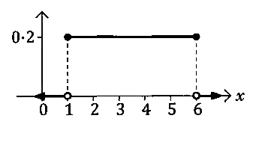

Cumulative Distribution Functions for CRVs
Looking at an example in the following uniform PDF:
$$f\left(x\right)=\left\{\begin{aligned}0.2, 1≤x≤6 \\ 0, for all other x\end{aligned}\right.$$
If we take $k$ as an arbitrary value with $1 ≤ k ≤$6, then:
$$P\left(X≤k\right)=\int_{1}^{k}{0.2 dx}$$
$$={\left[0.2x\right]}_{1}^{k}$$
$$=0.2(k−1)$$
Hence the cumulative distribution function for f(x) would be as follows:
$$F\left(x\right)=P\left(X≤x\right)=\left\{\begin{aligned}0 \\ 0.2(x−1) \\ 1\end{aligned}\right. \begin{matrix}for \\ for \\ for\end{matrix} \begin{matrix}x<1 \\ 1≤x≤6 \\ x>6\end{matrix}$$

Slide 16

Properties of CDF
Given a PDF:
$$g\left(x\right)=\left\{\begin{aligned}f\left(x\right), c≤x≤d \\ 0, for all other x\end{aligned}\right.$$
$F\left(c\right)= P\left(X≤c\right)=0$
$F\left(d\right)= P\left(X≤d\right)=1$
If $x_{1}≤x_{2}⇒F\left(x_{1}\right)≤F\left(x_{2}\right)∴F$ is a non-decreasing function

Slide 17
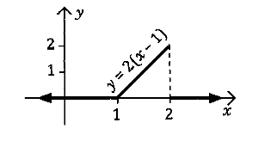

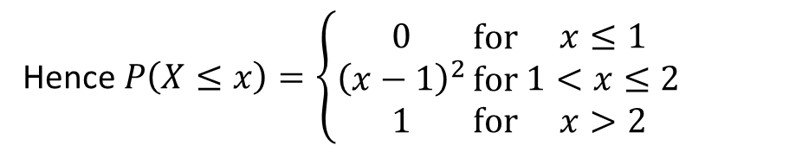


Guided Practice
Consider the triangular pdf shown, determine its cumulative distribution function.
Determine $P\left(X≤k\right)$ for $1≤k≤2$
$$P\left(X≤k\right)=\int_{1}^{k}{2\left(x−1\right) dx}$$
$${=\left[{\left(x−2\right)}^{2}\right]}_{1}^{k}$$
$$={\left(k−1\right)}^{2}$$
Hence $P\left(X≤x\right)=\left\{\begin{aligned}0 \\ {\left(x−1\right)}^{2} \\ 1\end{aligned}\right.\begin{matrix}for \\ for \\ for \end{matrix}\begin{matrix}x≤1 \\ 1<x≤2 \\ x>2\end{matrix}$

Slide 18











Guided Practice
Given the probability distribution function,
$$f\left(x\right)=\left\{\begin{aligned}\frac{5}{x^{2}}, x≥5 \\ 0, x<5\end{aligned}\right.$$
Determine the cumulative distribution function, $F(x)$
Use the cumulative distribution function to find: (i) $P\left(X≤7\right)$ (ii) $P(X≥6)$ (iii) $P(10≤X≤20)$
Determine $P\left(X≤k\right)$ for $k≥5$
$$F\left(x\right)=P\left(X≤x\right)=\left\{\begin{aligned}0, x<5 \\ 1−\frac{5}{x}, x≥5\end{aligned}\right.$$
$$P\left(X≤k\right)=\int_{5}^{k}{\frac{5}{x^{2}}dx}$$
$$=\int_{5}^{k}{5x^{−2}dx}$$
$$bi) P\left(X≤7\right)=1−\frac{5}{7}=\frac{2}{7}$$
$$ii) P\left(X≥6\right)=1−P(X<6)$$
$$iii) P\left(10≤X≤20\right)=P\left(X≤20\right)−P(X≤10)$$
$$={\left[\frac{5}{−1}x^{−1}\right]}_{5}^{k}$$
$$=1−\left(1−\frac{5}{6}\right)=\frac{5}{6}$$
$$=1−\frac{5}{20}−\left(1−\frac{5}{10}\right)=\frac{5}{20}=\frac{1}{4}$$
$$={\left[−\frac{5}{x}\right]}_{5}^{k}$$
$$=−\frac{5}{k}+1$$

Slide 19





Guided Practice
Given the cumulative distribution function,
$$F\left(x\right)=\left\{\begin{aligned}0, x<0 \\ \frac{x^{2}}{9}, 0≤x≤3 \\ 1, x>3\end{aligned}\right.$$
Determine the probability distribution function
$$f\left(x\right)=F^{′}\left(x\right)$$
$$=\frac{d}{dx}\left(\frac{x^{2}}{9}\right)$$
$$=\frac{2x}{9}$$
$$f\left(x\right)=\left\{\begin{aligned}\frac{2x}{9}, 0≤x≤3 \\ 0, for all other x\end{aligned}\right.$$

Slide 20














Guided Practice
Given the cdf of a random variable $X$,
$$F\left(x\right)=\left\{\begin{aligned}1−\frac{10}{x}, x>10 \\ 0, x≤5\end{aligned}\right.$$
Determine
$P(X<30)$
The median of $X$
The interquartile range of $X$
a) $P\left(X<30\right)=1−\frac{10}{30}=\frac{2}{3}$
c) $P\left(X≤b\right)=\frac{3}{4}, P\left(X≤a\right)=\frac{1}{4}$
$$1−\frac{10}{b}=\frac{3}{4}$$
$$1−\frac{10}{a}=\frac{1}{4}$$
b) $P\left(X≤m\right)=\frac{1}{2}$
$$1−\frac{10}{m}=\frac{1}{2}$$
$$\frac{10}{b}=\frac{1}{4}$$
$$\frac{10}{a}=\frac{3}{4}$$
$$\frac{10}{m}=\frac{1}{2}$$
$$b=40$$
$$a=\frac{40}{3}$$
$$IQR=40−\frac{40}{3}=\frac{80}{3}$$
$$m=20$$

Slide 21
Independent Practice
Complete Cambridge Ex 10D & 10E + Worksheet

